Slide 1
Evolution of Trans medicine
Aaron Kimberly, RN

Slide 2
Origins (Prior to 1990)
Sex ratio: Mostly males
“Watchful waiting”
Assessments by psychiatrists/psychologists
Real-Life Experience (1 year)
Psychotherapy
Hormones/surgery
Low regret rate
Transsexuals (gay/lesbians with GID)
Transvestites
(Heterosexual men with paraphillia)
Gender Clinic
(E.g. Trans Health Program in Vancouver)

Slide 3
1990-2000
Queer theory – Judith Butler’s “Gender Trouble” (1990), “Bodies That Matter (1993)
Transgender, Genderqueer
Drag Queens, Drag Kings
Popular media
“Queering” culture

Slide 4
Early 2000
Transsexuals (gay/lesbian)
Transvestites
(Heterosexual men)
Transgender/genderqueer
Gender Clinic

Slide 5
REBRANDING
“Transgender”
(males/females of any sexual orientation)
Intense lobbying
“Gatekeeping” seen as oppressive
Aggressive denial of different types of gender dysphoria
2003 – Smearing of Dr Bailey
E.g. Restructuring of Trans Health Program
Gender Clinic

Slide 6
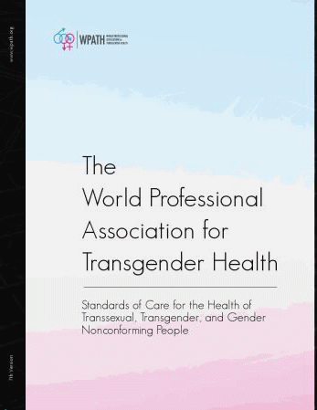
WPATH SOC 7 - 2012
Beginnings of the “Affirmative Model” based on Dutch Clinic
Less assessment
No Real-Life Test
No required psychotherapy, but still recommended
Early intro of “Informed Consent Model” (Fenway Clinic)

Slide 7
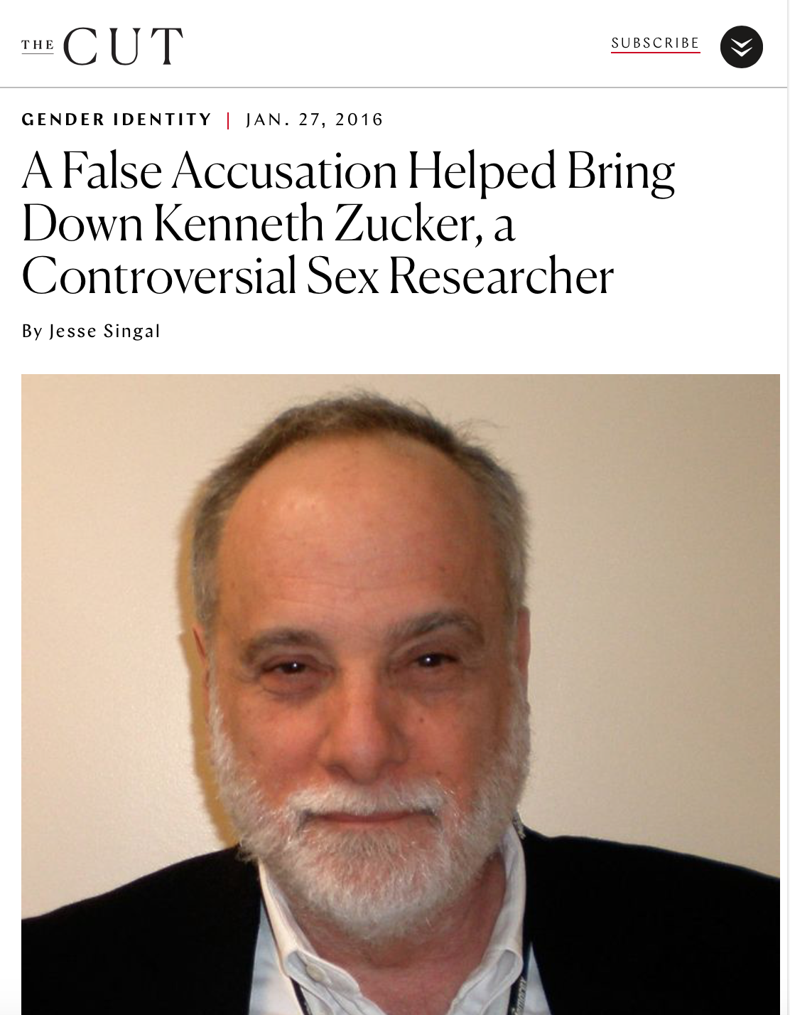
2012-Present
Human Rights Framework
Growth of Informed-Consent/Harm Reduction Models
Psychotherapy criminalized as “Conversion Therapy”
More emphasis on pediatric transitions
2015 – Dr Kenneth Zucker fired from clinic
(Received an apology and settlement in 2018)

Slide 8
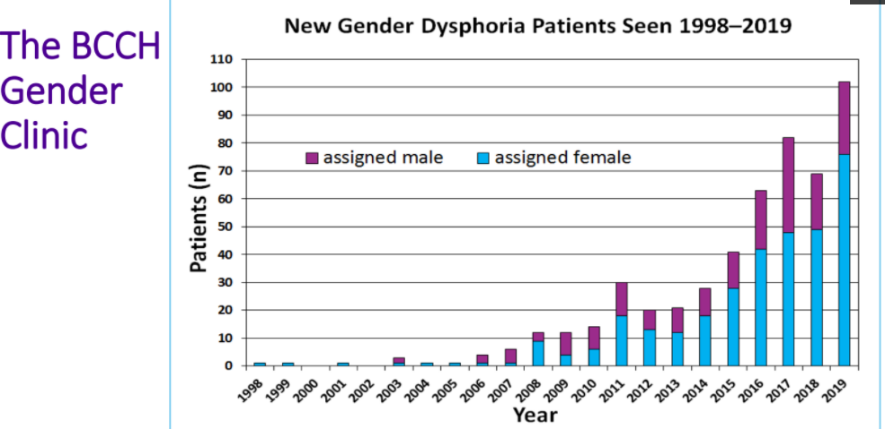

Slide 9
COHORTS
“Trans”
Transsexuals (gay/lesbian)
Transvestites
(Heterosexual men)
Transgender/Non-Binary/Genderqueer etc.

Slide 10
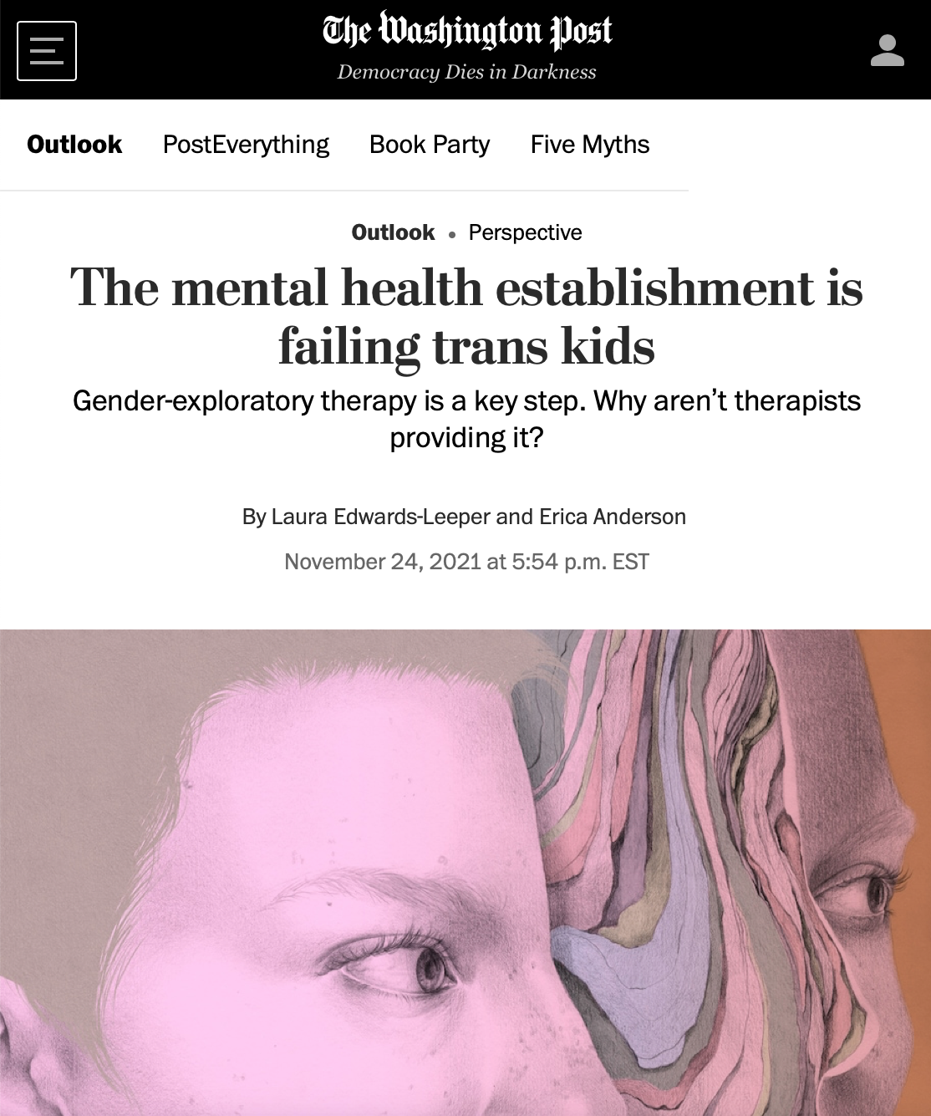
ROGD/CURRENT Crisis
Anecdotal evidence – clinicians and parents
Dr Lisa Littman’s study 2018
Abigail Shrier’s book: Irreversible Damage (2021)
Emerging evidence, patient reports, detransition increasing
Role of social media and socio-cultural influence
WHISTLEBLOWERS:
UK, Finland, Sweden, Australian, New Zealand, France, USA
International call for Gender Exploratory Model

